Slide 1


API Testing Mastery
Pramod Dutta Lead SDET.
POSTMAN Mastery

Slide 2
Agenda of Session
POSTMAN OverView
Import External Request.
History
WorkSpace in Postman
Postman Tabs - Param, Auth,
Headers, Body, Pre-req, Post Req(Test), Settings
Postman Console.

Slide 3
Before We Start…..
Join Private Telegram
https://sdet.live/apibatch

Slide 4

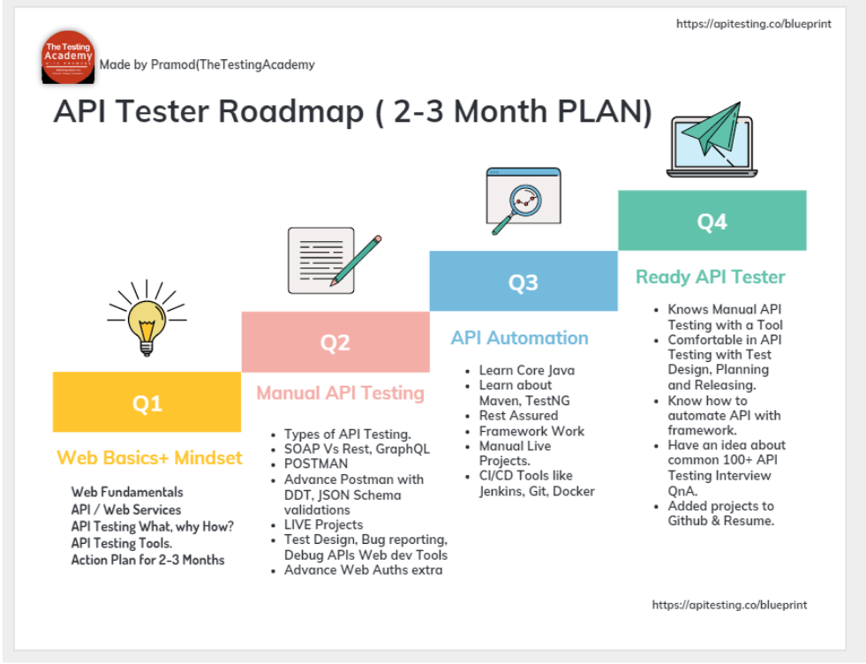
API Tester ROADMAP

Slide 5
POSTMAN Basics

Slide 6
POSTMAN Basics
OverView
Import External Request.
History
WorkSpace in Postman
Postman Tabs - Param, Auth, Headers, Body, Pre-req, Post Req(Test), Settings
Postman Console.

Slide 7
POSTMAN Basics
Import External Request.

Slide 8
POSTMAN Basics
History

Slide 9
POSTMAN Basics
WorkSpace in Postman

Slide 10
POSTMAN Basics
Postman Tabs - Param, Auth, Headers, Body, Pre-req, Post Req(Test), Settings.

Slide 11
POSTMAN Basics
Postman Console.

Slide 12
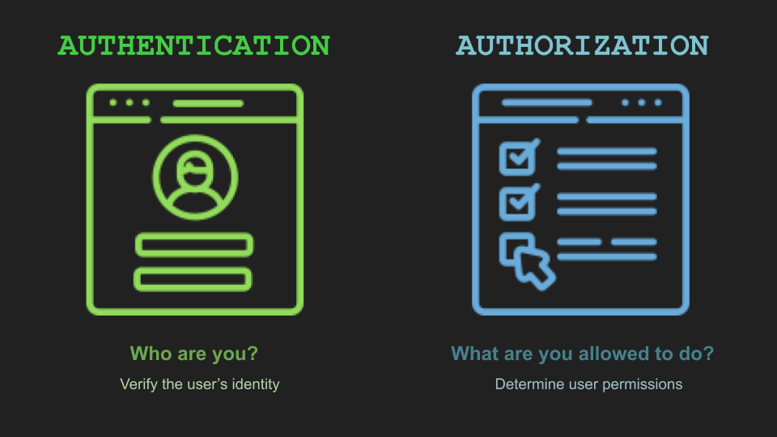
Authorization VS Authentication

Slide 13
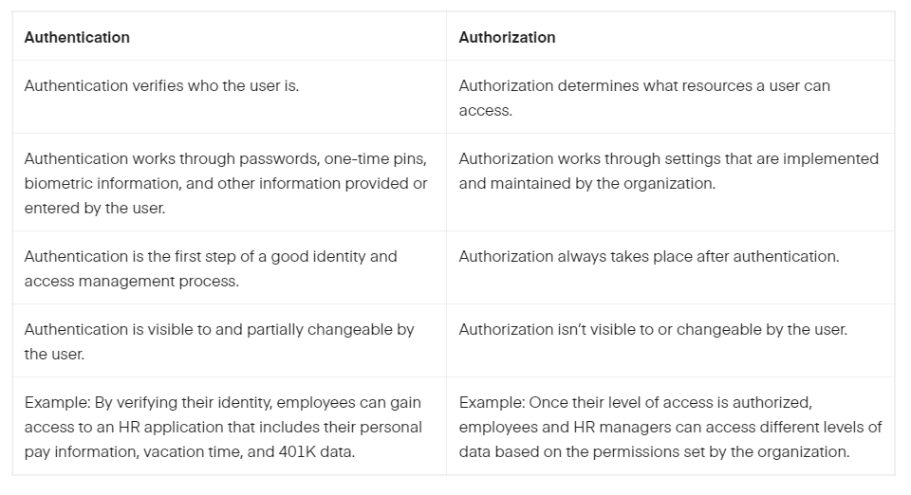
Authentication vs Authorization

Slide 14
Authorization
APIs use authorization to ensure that client requests access data securely
Authorization types
No auth
API key
Bearer token
Basic auth
Digest auth
OAuth 1.0
OAuth 2.0
Hawk authentication
AWS Signature
NTLM authentication
Akamai EdgeGrid

Slide 15
JWT Token
JSON Web Tokens are an open, industry standard RFC 7519 method for representing claims securely between two parties.
https://jwt.io/

Slide 16
Bearer Authentication
Bearer authentication (also called token authentication) is an HTTP authentication scheme that involves security tokens called bearer tokens
Authorization: Bearer <token>
The name “Bearer authentication” can be understood as “give access to the bearer of this token.”
The bearer token is a cryptic string, usually generated by the server in response to a login request. The client must send this token in the Authorization header when making requests to protected resources:

Slide 17
API Keys
Some APIs use API keys for authorization. An API key is a token that a client provides when making API calls. The key can be sent in the query string or Headers:
GET /something?api_key=abcdef12345
or as a cookie:
GET /something HTTP/1.1
Cookie: X-API-KEY=abcdef12345
X-API-KEY

Slide 18
Cookie Authentication
Cookie authentication uses HTTP cookies to authenticate client requests and maintain session information.
The client sends a login request to the server.
On the successful login, the server response includes the Set-Cookie header that contains the cookie name, value, expiry time and some other info. Here is an example that sets the cookie named JSESSIONID:
Set-Cookie: JSESSIONID=abcde12345; Path=/; HttpOnly
The client needs to send this cookie in the Cookie header in all subsequent requests to the server.
Cookie: JSESSIONID=abcde12345
On the logout operation, the server sends back the Set-Cookie header that causes the cookie to expire.

Slide 19
OAuth 2.0
OAuth 2.0 is an authorization protocol that gives an API client limited access to user data on a web server. GitHub, Google, and Facebook APIs notably use it.
an OAuth 2.0 server issues access tokens that the client applications can use to access protected resources on behalf of the resource owner.
OAuth relies on authentication scenarios called flows,
https://developer.spotify.com/console/get-album/

Slide 20
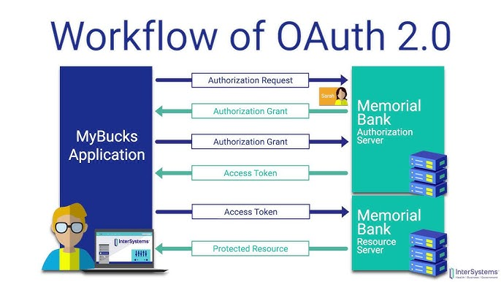
OAuth 2.0

Slide 21
Quiz
Status Code for Invalid API Keys.
401 Response

Slide 22
Thanks, for attending Class
I hope you liked it. Say Thanks in Comment :)

Slide 23
Fin.

